Slide 1
IoT Physical Devices and Endpoints - RaspberryPi
Dr. Phanindra Thota

Slide 2
IoT Physical Devices and Endpoints - RaspberryPi
Introduction to RaspberryPi
About the RaspberryPi Board:
Hardware Layout
Operating Systems on RaspberryPi
Configuring RaspberryPi
Programming RaspberryPi with Python.

Slide 3
 | Arduino | Raspberry Pi
Architecture | A microcontroller platform. It’s designed to run simple programs and perform tasks like reading sensors, controlling LEDs, motors, or other actuators. Common models like the Arduino Uno use microcontrollers such as the ATmega328. | A single-board computer. It runs a full operating system (often Raspberry Pi OS, based on Linux) and can handle complex tasks like running multiple programs, networking, or even acting as a lightweight server.
Operating System | Doesn’t have an operating system. It runs a single program at a time, loaded directly onto its memory | Has a fully functional OS, allowing for multitasking, web browsing, file management, and more.
Power and Performance | Limited in terms of processing power (16-32 MHz) and memory (usually 2-8 KB RAM). It's designed for low-power, real-time tasks. | Far more powerful, with multi-core processors, higher RAM (512MB to 8GB), USB ports, HDMI output, and the ability to run a desktop environment.
Connectivity and Interfaces | Typically has fewer interfaces. It comes with digital and analog input/output pins to interface with sensors, motors, or other electronics. It lacks native support for peripherals like monitors or keyboards. | Has a wide range of connectivity options like USB ports, HDMI, Ethernet, Wi-Fi, and Bluetooth. It also supports GPIO pins for hardware interfacing like Arduino, but with more capabilities.

Slide 4
Programming | Primarily programmed using the Arduino IDE with C/C++. It’s simpler and more focused on interacting with hardware. | You can program it using many languages like Python, C, Java, etc. It supports a wide variety of software and development environments since it's a full computer.
Use Case | Ideal for simpler projects like robotics, sensor monitoring, motor control, or other embedded systems where real-time control and low power are essential. | Suited for more complex applications such as programming, running servers, media centers, or even AI applications. It’s often used for educational purposes, prototyping, or projects that require significant processing power.
Arduino is for simple, low-power hardware control tasks.
Raspberry Pi is for more complex, high-power computing tasks.

Slide 5
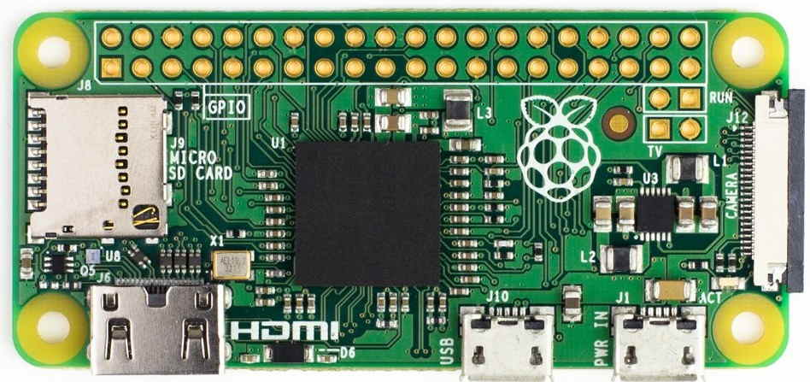
Raspberry Pi zero Board

Slide 6
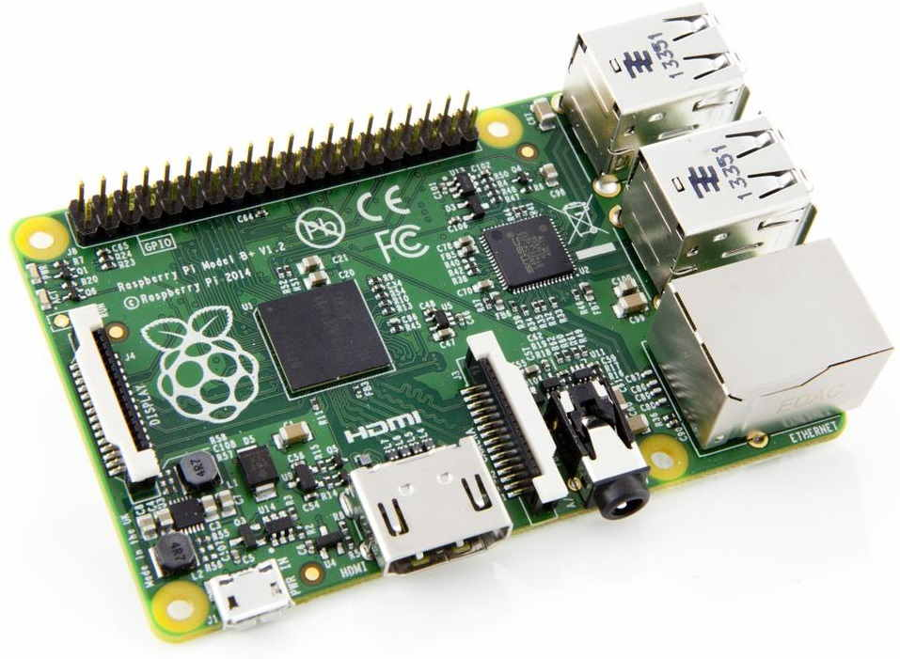
Raspberry Pi Board

Slide 7
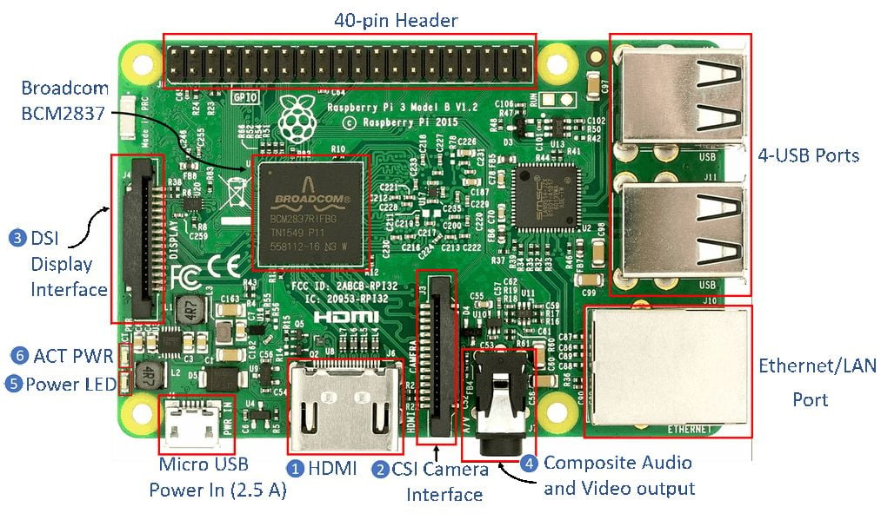
Raspberry Pi 3

Slide 8
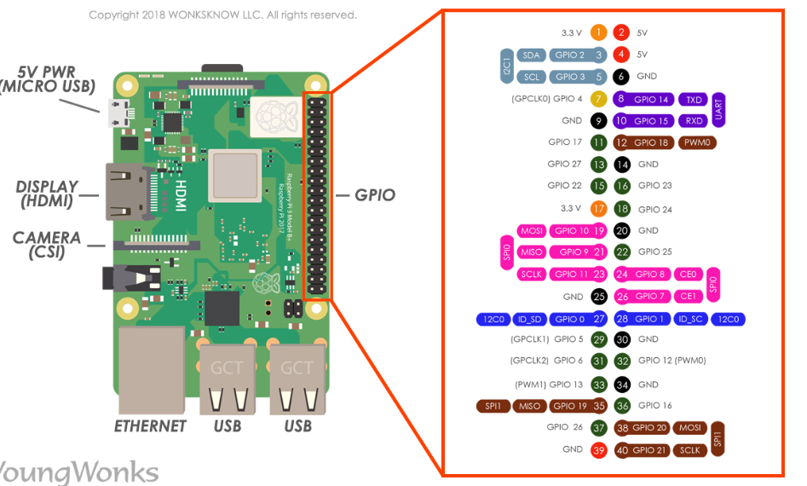

Slide 9
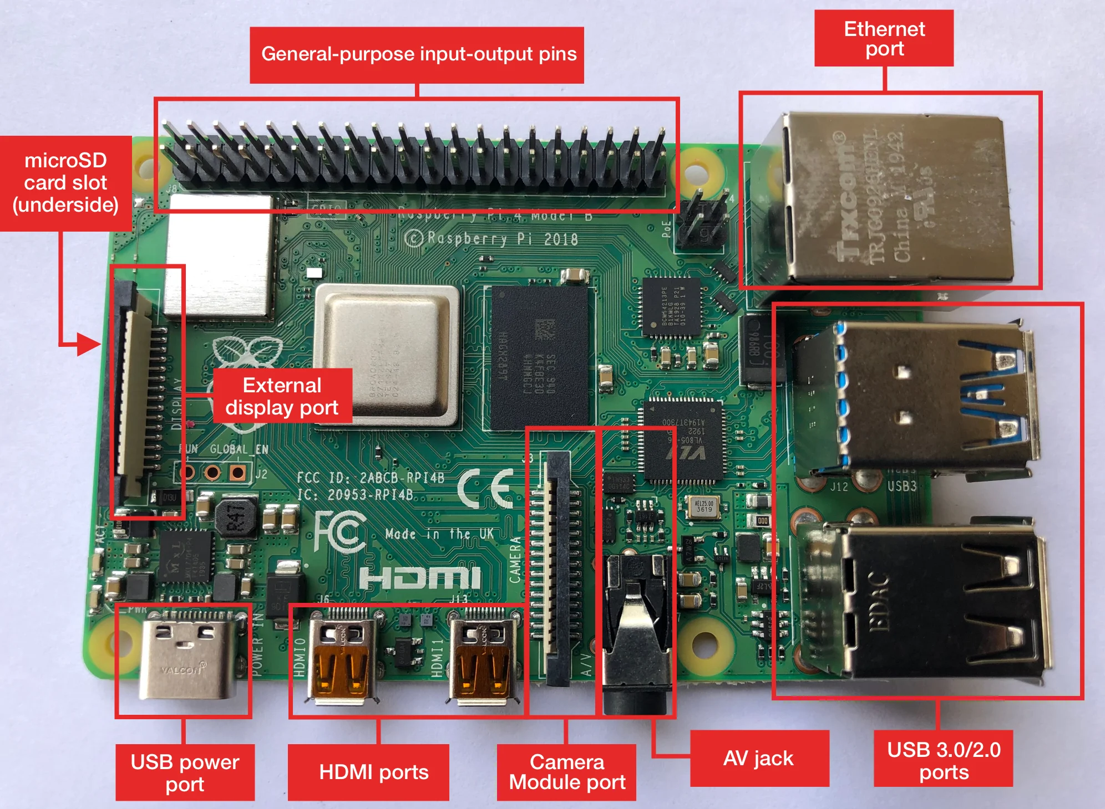
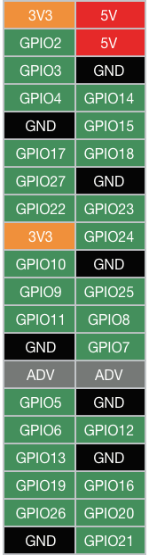

Slide 10
A Raspberry Pi 3 board has 40 pins on it.
Among these pins, we have 4 power pins on the Raspberry Pi, 2 of which are 5v pins and another 2 are 3.3v pins.
The 5v power pins are connected directly to the Raspberry Pi's power input and we can use these pins to run low power applications.
There are 8 ground pins and all of these are connected to each other
28 GPIO pins, labeled starting from GPIO 0 and going up to GPIO 27.
The GPIO (General Purpose Output and Input) pins, as indicated by their full form, can be programmed to be output pins or input pins. So we can set values of output pins and we can even read values of input pins.
The GPIO pins can be digitally programmed so that they can be turned ON or OFF.
The output of any GPIO pin is 3.3v and can be used to control output components like an LED or a motor. These ON/OFF conditions can also be interpreted as a Boolean True/False, 1/0 or HIGH/LOW.
These are the common types of pins on a Raspberry Pi 3 board. Some of these pins also have a dual function. For example, pin 3 or GPIO 2 also acts like an I2C pin.

Slide 11
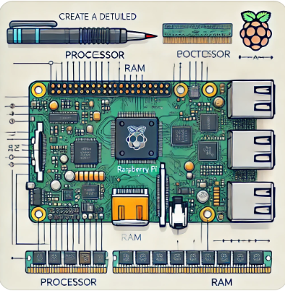
About the RaspberryPi Board: Hardware Layout
: Processor & RAM
: USB Ports
: Ethernet Port
: HDMI Output
: Composite Video Output
: Audio Output
: GPIO Pins
: Display Serial Interface (DSI)
: Camera Serial Interface (CSI)
: Status LEDs
: SD Card Slot
: Power Input
Processor & RAM
Processor:
ARM-based,
700 MHz Low Power ARM1176JZ-F
RAM: 512 MB SDRAM
Found in Raspberry Pi Model B, Revision 2

Slide 12
About the RaspberryPi Board: Hardware Layout
: Processor & RAM
: USB Ports
: Ethernet Port
: HDMI Output
: Composite Video Output
: Audio Output
: GPIO Pins
: Display Serial Interface (DSI)
: Camera Serial Interface (CSI)
: Status LEDs
: SD Card Slot
: Power Input
USB Ports
4 USB ports
Provides current up to 100mA
External powered hub needed for devices that require more current

Slide 13
About the RaspberryPi Board: Hardware Layout
: Processor & RAM
: USB Ports
: Ethernet Port
: HDMI Output
: Composite Video Output
: Audio Output
: GPIO Pins
: Display Serial Interface (DSI)
: Camera Serial Interface (CSI)
: Status LEDs
: SD Card Slot
: Power Input
Ethernet Port
RJ45 Ethernet port for wired internet connection
Supports USB Wi-Fi adapters for wireless internet

Slide 14
About the RaspberryPi Board: Hardware Layout
: Processor & RAM
: USB Ports
: Ethernet Port
: HDMI Output
: Composite Video Output
: Audio Output
: GPIO Pins
: Display Serial Interface (DSI)
: Camera Serial Interface (CSI)
: Status LEDs
: SD Card Slot
: Power Input
HDMI Output
HDMI port for video and audio output
Can connect to monitors via HDMI cable
HDMI to DVI adapter can be used for DVI-only monitors

Slide 15
About the RaspberryPi Board: Hardware Layout
: Processor & RAM
: USB Ports
: Ethernet Port
: HDMI Output
: Composite Video Output
: Audio Output
: GPIO Pins
: Display Serial Interface (DSI)
: Camera Serial Interface (CSI)
: Status LEDs
: SD Card Slot
: Power Input
Composite Video Output
RCA jack supports PAL and NTSC video output
Used to connect to old TVs with RCA input

Slide 16
About the RaspberryPi Board: Hardware Layout
: Processor & RAM
: USB Ports
: Ethernet Port
: HDMI Output
: Composite Video Output
: Audio Output
: GPIO Pins
: Display Serial Interface (DSI)
: Camera Serial Interface (CSI)
: Status LEDs
: SD Card Slot
: Power Input
Audio Output
3.5mm audio jack for old TVs
Lower quality compared to HDMI audio output

Slide 17
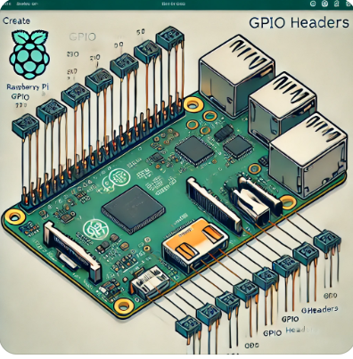
About the RaspberryPi Board: Hardware Layout
: Processor & RAM
: USB Ports
: Ethernet Port
: HDMI Output
: Composite Video Output
: Audio Output
: GPIO Pins
: Display Serial Interface (DSI)
: Camera Serial Interface (CSI)
: Status LEDs
: SD Card Slot
: Power Input
GPIO Pins
General-purpose input/output pins (GPIO)
Types of Pins:
True GPIO
I2C interface
SPI interface
Serial Rx and Tx

Slide 18
About the RaspberryPi Board: Hardware Layout
: Processor & RAM
: USB Ports
: Ethernet Port
: HDMI Output
: Composite Video Output
: Audio Output
: GPIO Pins
: Display Serial Interface (DSI)
: Camera Serial Interface (CSI)
: Status LEDs
: SD Card Slot
: Power Input
Display Serial Interface (DSI)
Connects to an LCD panel

Slide 19
About the RaspberryPi Board: Hardware Layout
: Processor & RAM
: USB Ports
: Ethernet Port
: HDMI Output
: Composite Video Output
: Audio Output
: GPIO Pins
: Display Serial Interface (DSI)
: Camera Serial Interface (CSI)
: Status LEDs
: SD Card Slot
: Power Input
Camera Serial Interface (CSI)
Connects to a camera module

Slide 20
About the RaspberryPi Board: Hardware Layout
: Processor & RAM
: USB Ports
: Ethernet Port
: HDMI Output
: Composite Video Output
: Audio Output
: GPIO Pins
: Display Serial Interface (DSI)
: Camera Serial Interface (CSI)
: Status LEDs
: SD Card Slot
: Power Input
Status LEDs
5 Status LEDs
Indicate different system statuses

Slide 21
About the RaspberryPi Board: Hardware Layout
: Processor & RAM
: USB Ports
: Ethernet Port
: HDMI Output
: Composite Video Output
: Audio Output
: GPIO Pins
: Display Serial Interface (DSI)
: Camera Serial Interface (CSI)
: Status LEDs
: SD Card Slot
: Power Input
SD Card Slot
No built-in OS or storage
Requires an SD card (at least 8GB) with a Linux image
Appendix A explains setting up NOOBS

Slide 22
About the RaspberryPi Board: Hardware Layout
: Processor & RAM
: USB Ports
: Ethernet Port
: HDMI Output
: Composite Video Output
: Audio Output
: GPIO Pins
: Display Serial Interface (DSI)
: Camera Serial Interface (CSI)
: Status LEDs
: SD Card Slot
: Power Input
Power Input
Uses a micro-USB connector for power input

Slide 23
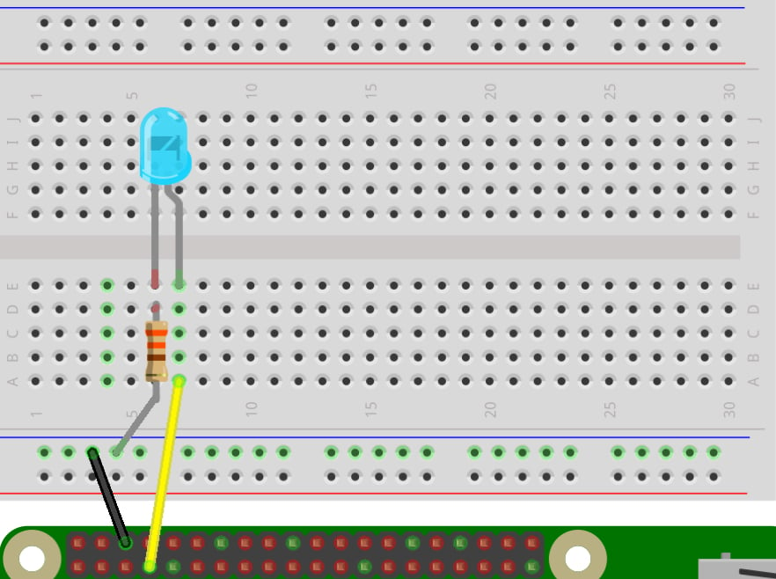
LED blink using the Raspberry Pi and Python

Slide 24
LED blink using the Raspberry Pi and Python
Initialize the GPIO ports
Turn the LED on and off in 1 second intervals
import RPi.GPIO as GPIO # Import Raspberry Pi GPIO library
from time import sleep # Import the sleep function from the time module
GPIO.setmode(GPIO.BOARD) # Use physical pin numbering
GPIO.setup(18, GPIO.OUT, initial=GPIO.LOW) # Set pin 18 to be an output pin and set initial value to low (off)
while True: # Run forever
GPIO.output(18, GPIO.HIGH) # Turn on
sleep(1) # Sleep for 1 second
GPIO.output(18, GPIO.LOW) # Turn off
sleep(1) # Sleep for 1 second

Slide 25
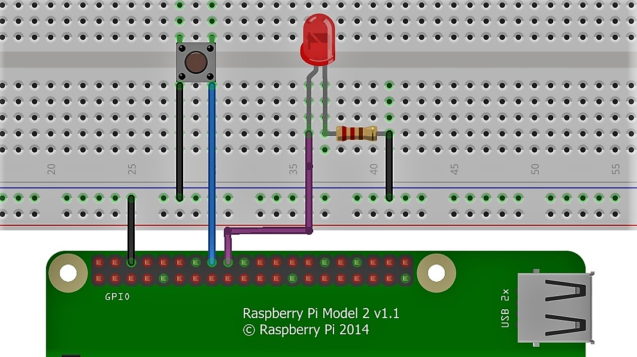
LED blink with Push Button using the Raspberry Pi and Python

Slide 26
